Slide 1
Chapter 11: Cryptographic Hash Functions
Freshman Seminar
2022.01.28
Sumin Sohn

Slide 2
Contents
11.1 Applications of Cryptographic Hash Functions
11.2 Two Simple Hash Functions
11.3 Requirements and Security
11.4 Hash Functions Based on CBC
11.5 SHA

Slide 3
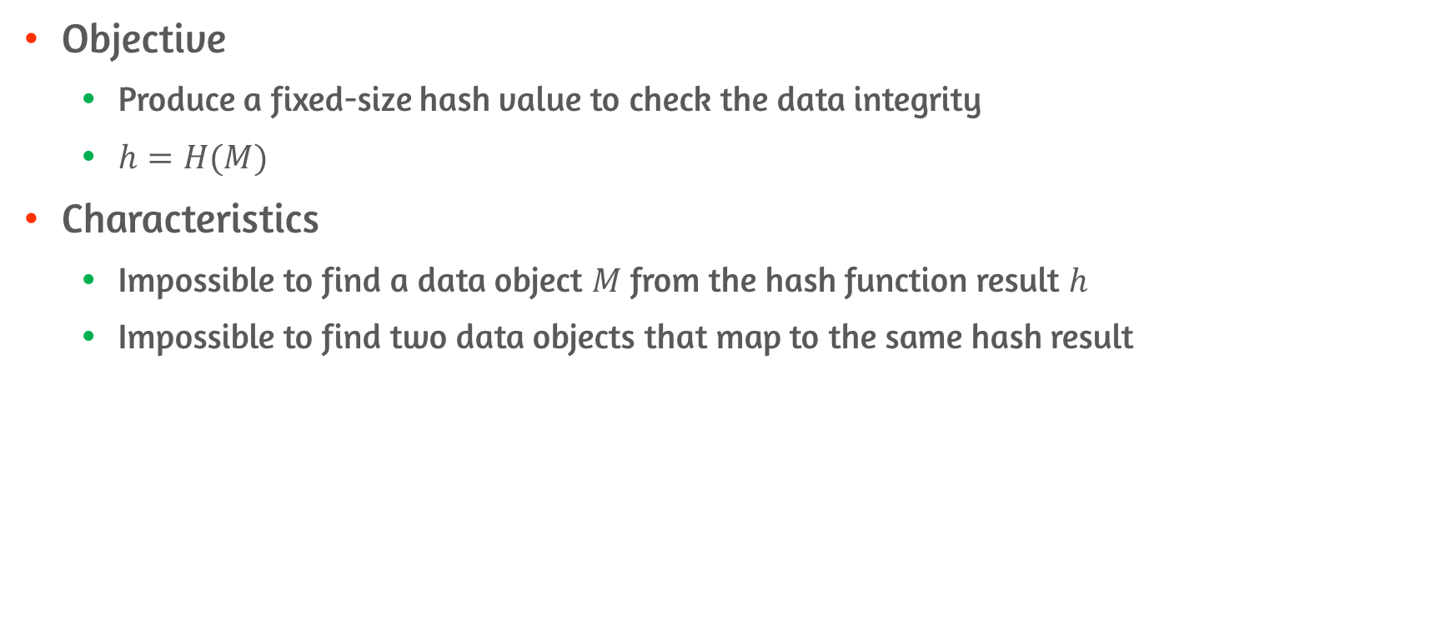
Cryptographic Hash Functions
Objective
Produce a fixed-size hash value to check the data integrity
$h=H(M)$
Characteristics
Impossible to find a data object $M$ from the hash function result $h$
Impossible to find two data objects that map to the same hash result

Slide 4
11.1 Applications of Cryptographic Hash Functions

Slide 5
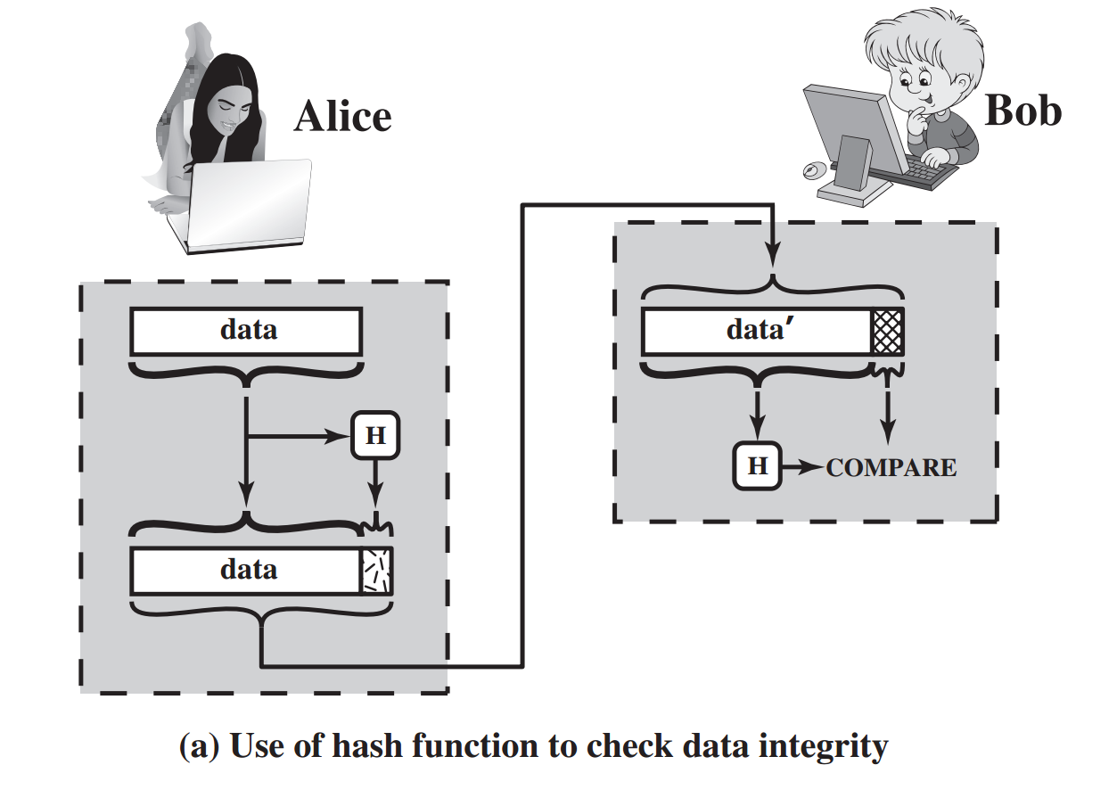
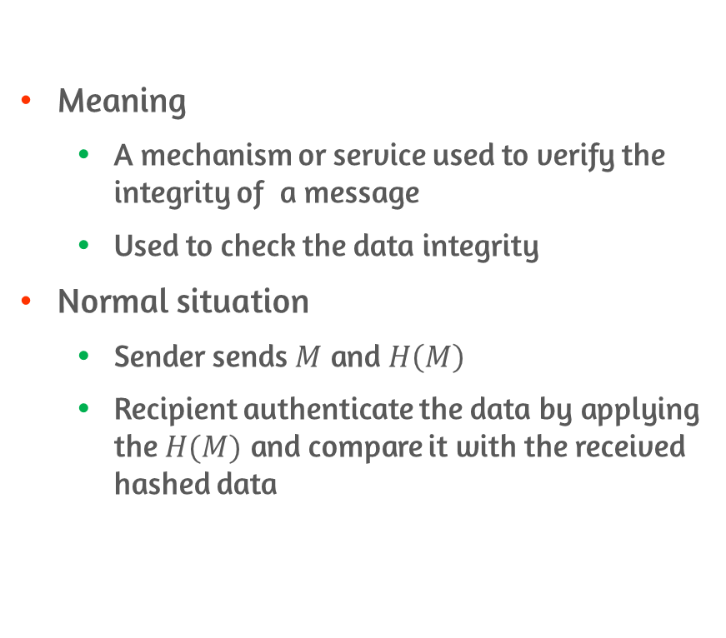
Message Authentication #1
Meaning
A mechanism or service used to verify the integrity of a message
Used to check the data integrity
Normal situation
Sender sends $M$ and $H\left(M\right)$
Recipient authenticate the data by applying the $H(M)$ and compare it with the received hashed data

Slide 6
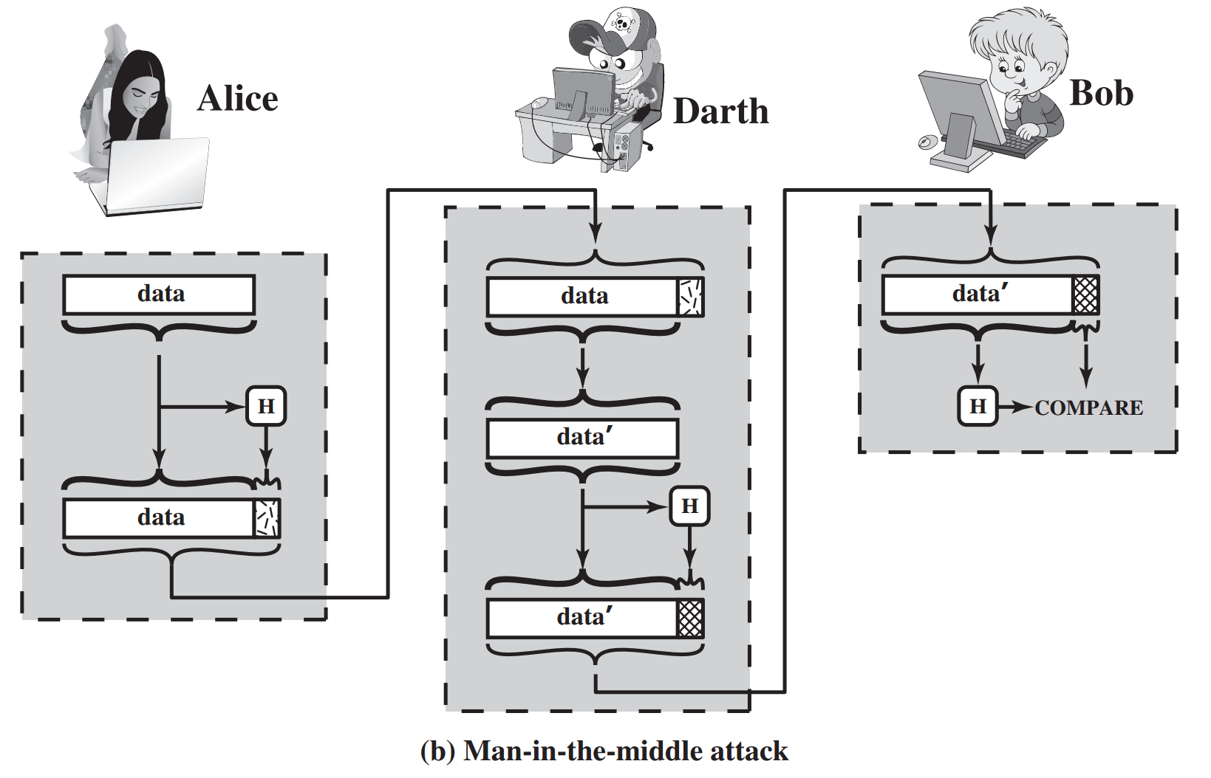
Message Authentication #2
Hash value must be protected in a secure fashion
Attacker could change the data if data not protected
Darth change the data
Darth apply same hash function
Bob doesn’t know whether or not data is changed

Slide 7
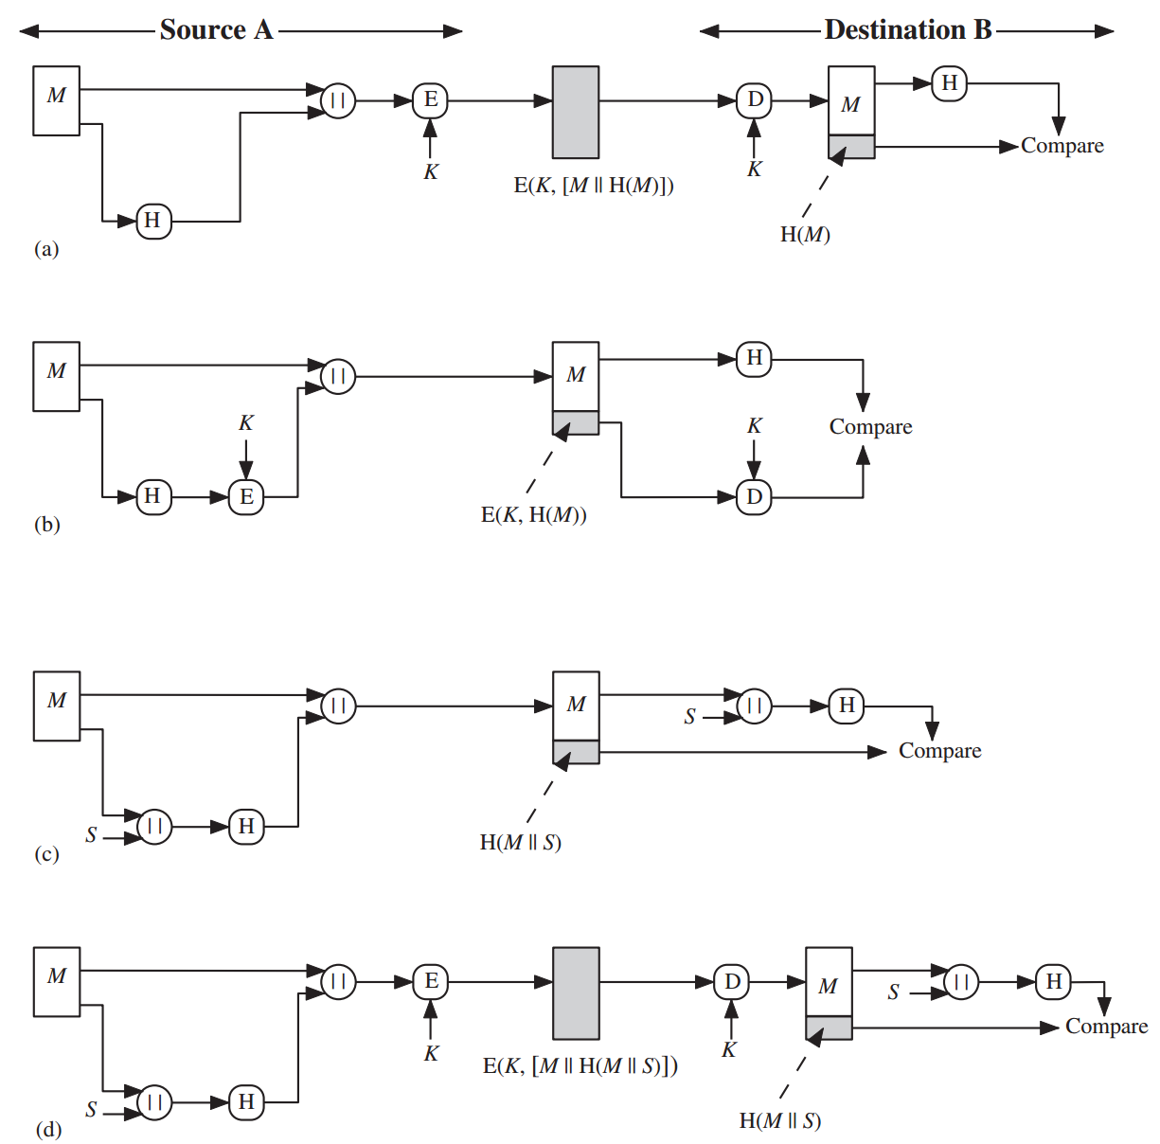
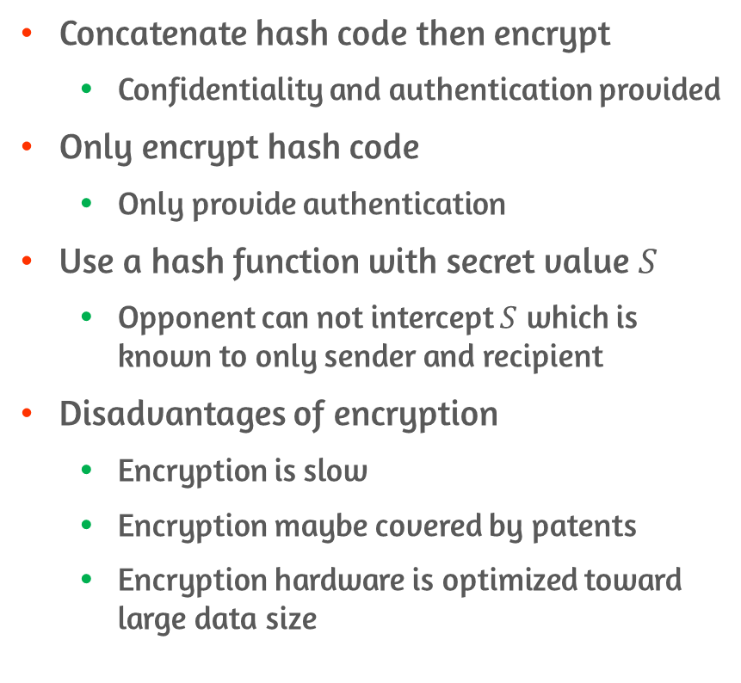
Examples of Message Authentication
Concatenate hash code then encrypt
Confidentiality and authentication provided
Only encrypt hash code
Only provide authentication
Use a hash function with secret value $S$
Opponent can not intercept $S$ which is known to only sender and recipient
Disadvantages of encryption
Encryption is slow
Encryption maybe covered by patents
Encryption hardware is optimized toward large data size

Slide 8
Message Authentication Code
Keyed hash function
Combination of hashing and encryption
Always produce fixed size output that is secure
Attacker can not change the data without knowing the secret key

Slide 9
Digital Signatures
The hash value of a message is encrypted with a private key
Verify the signature with a public key
Procedure
Hash code is encrypted using private key
Only the sender could encrypt
Using symmetric key provides confidentiality

Slide 10
Other Applications
One-way password file
Hash of password file is stored instead of password itself
Intrusion/virus detection
Store valid hashed value of certain file and detect possible modification
Pseudorandom number
Hash function can be used to produce random number

Slide 11
11.2 Two Simple Hash Functions

Slide 12
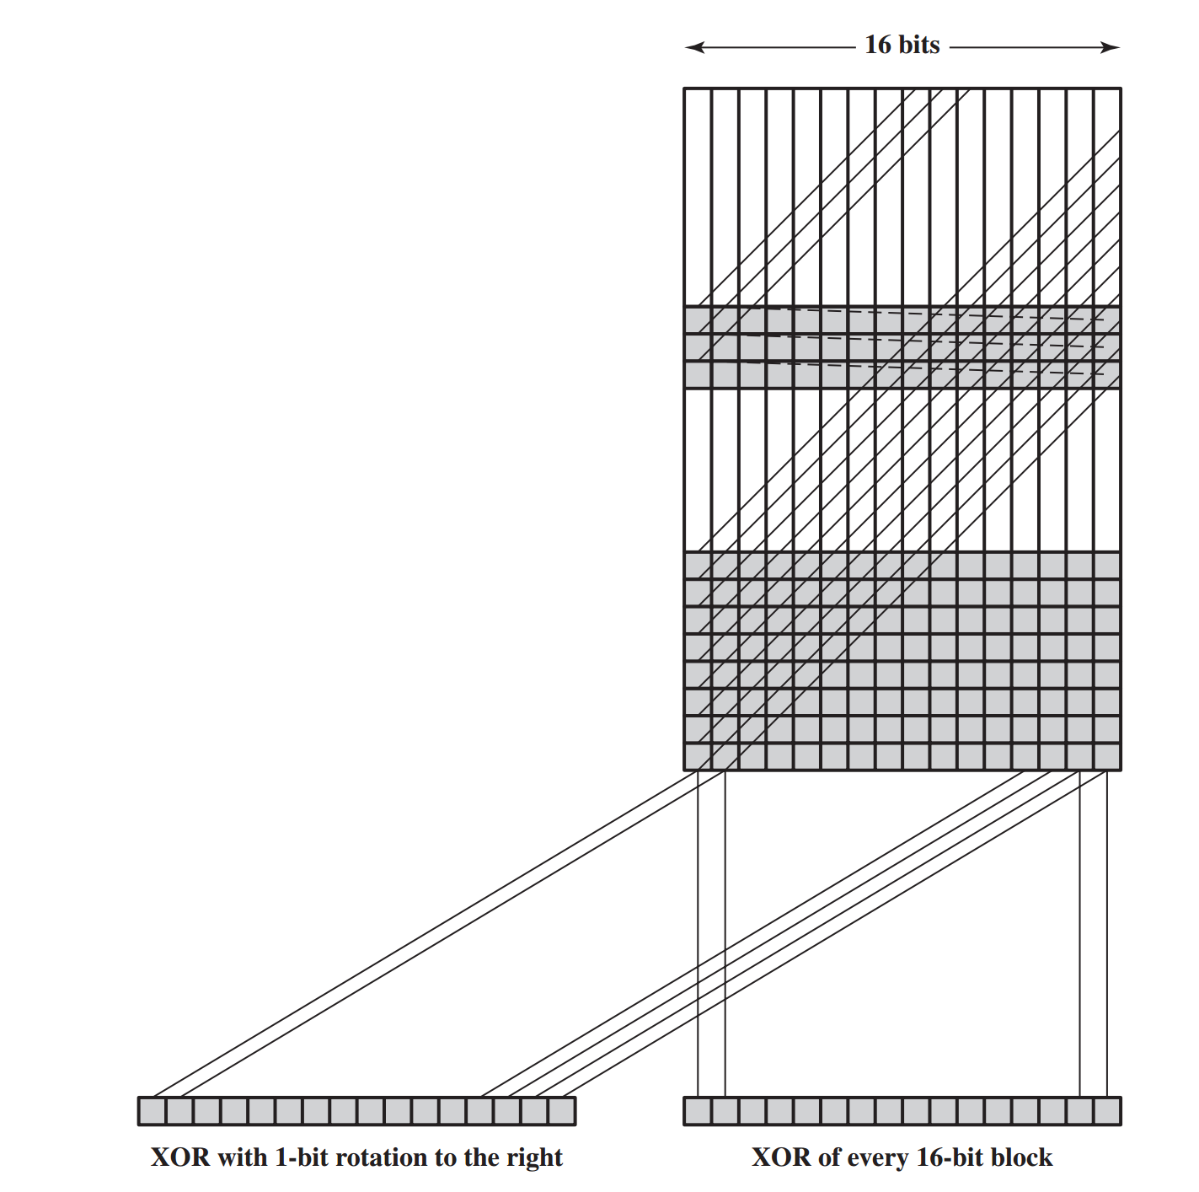
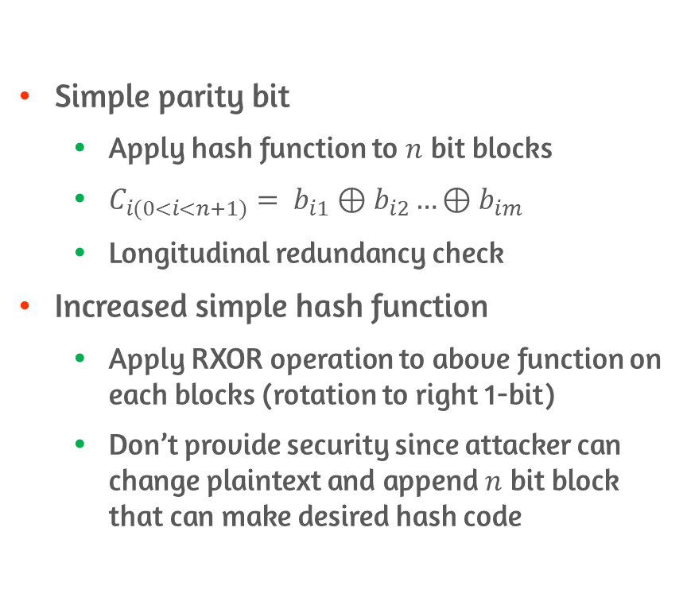

Two Simple Hash Function
Simple parity bit
Apply hash function to $n$ bit blocks
$C_{i(0<i<n+1)}= b_{i1}⊕b_{i2}…⊕b_{im}$
Longitudinal redundancy check
Increased simple hash function
Apply RXOR operation to above function on each blocks (rotation to right 1-bit)
Don’t provide security since attacker can change plaintext and append $n$ bit block that can make desired hash code

Slide 13
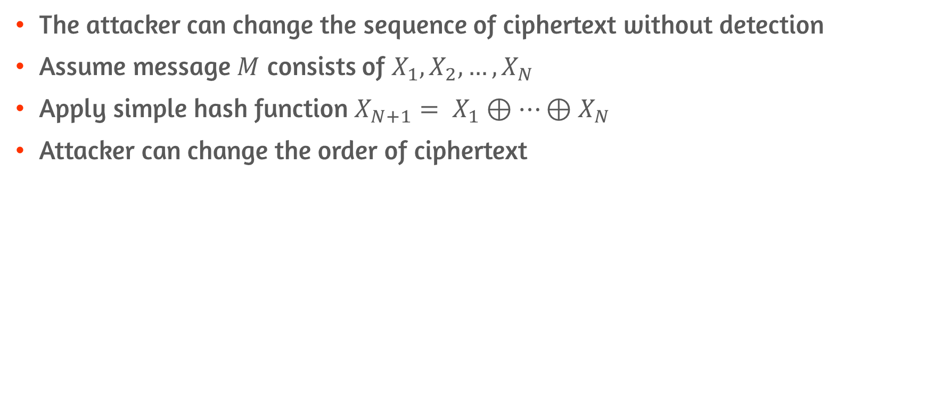
Possible Attack on TSHF
The attacker can change the sequence of ciphertext without detection
Assume message $M$ consists of $X_{1},X_{2},…,X_{N}$
Apply simple hash function $X_{N+1}= X_{1}⊕…⊕X_{N}$
Attacker can change the order of ciphertext

Slide 14
11.3 Requirements and Security

Slide 15
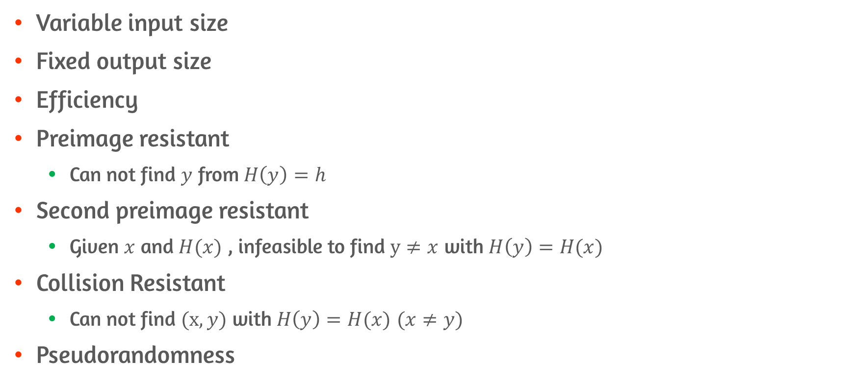
Requirements
Variable input size
Fixed output size
Efficiency
Preimage resistant
Can not find $y$ from $H\left(y\right)=h$
Second preimage resistant
Given $x$ and $H(x)$ , infeasible to find $y≠x$ with $H\left(y\right)=H(x)$
Collision Resistant
Can not find $(x,y)$ with $H\left(y\right)=H(x)$ $(x≠y)$
Pseudorandomness

Slide 16
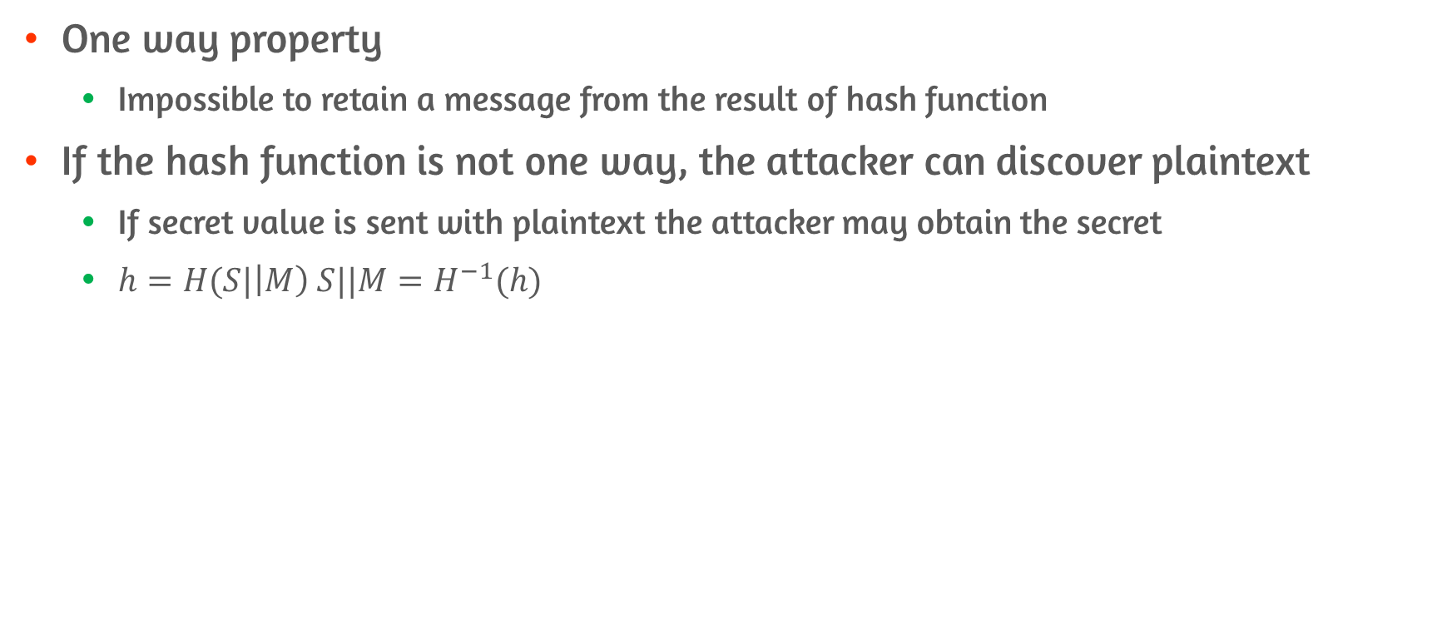
Preimage Resistant
One way property
Impossible to retain a message from the result of hash function
If the hash function is not one way, the attacker can discover plaintext
If secret value is sent with plaintext the attacker may obtain the secret
$h=H(S|\left|M\right) S||M=H^{−1}(h)$

Slide 17
Second Preimage Resistant
Infeasible to find an alternative message with the same hash value
This prevents forgery when an encrypted hash code is used
Attacker obtain a message plus its encrypted hash code
Attacker generate unencrypted hash code from a message
Attacker can generate an alternate message with same hash code if second preimage resistant is not provided

Slide 18
Collision Resistant
The final condition to be a strong hash function
E.g., if collision resistant is not provided
Bob writes debt message to Alice
Bob finds two message with the same hash value
One requires small amount money and one requires massive amount of money
Since two hash value is same, Bob can assert Alice signed on second message even though Alice signed on the first message

Slide 19
Pseudorandomness
Cryptographic hash function is used on key derivation and pseudorandom number generation
Three resistant properties depend on the randomness

Slide 20
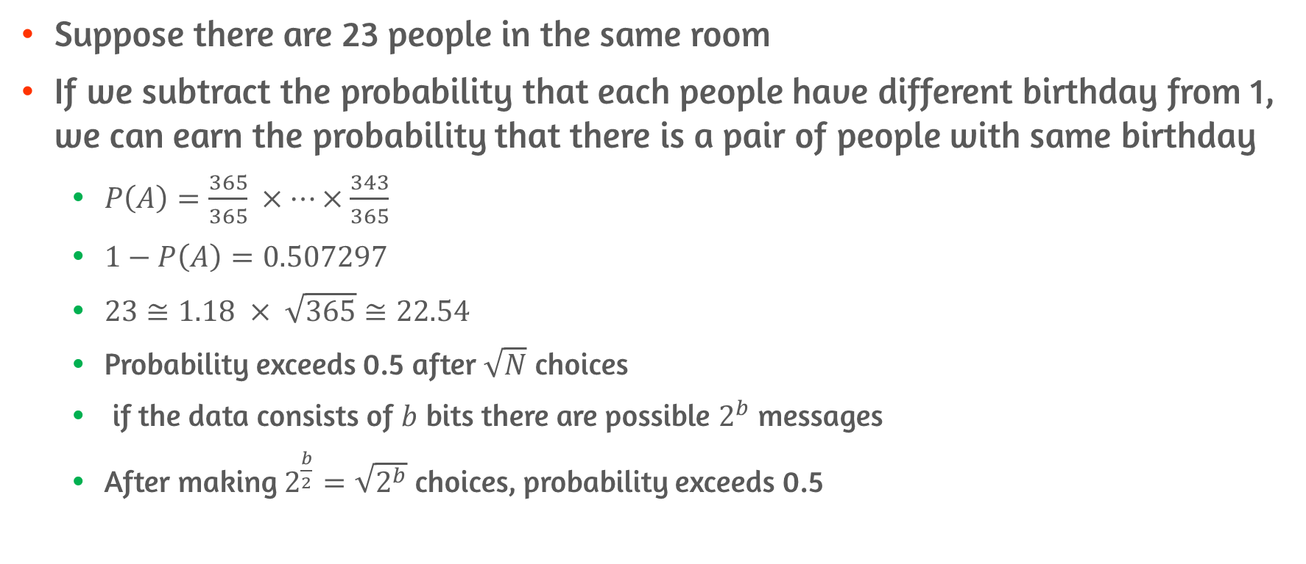
Birthday Paradox
Suppose there are 23 people in the same room
If we subtract the probability that each people have different birthday from 1, we can earn the probability that there is a pair of people with same birthday
$P\left(A\right)=\frac{365}{365} ×…×\frac{343}{365}$
$1−P\left(A\right)=0.507297$
$23≅1.18 × \sqrt{365}≅22.54$
Probability exceeds 0.5 after $\sqrt{N}$ choices
if the data consists of $b$ bits there are possible $2^{b}$ messages
After making $2^{\frac{b}{2}}=\sqrt{2^{b}}$ choices, probability exceeds 0.5

Slide 21
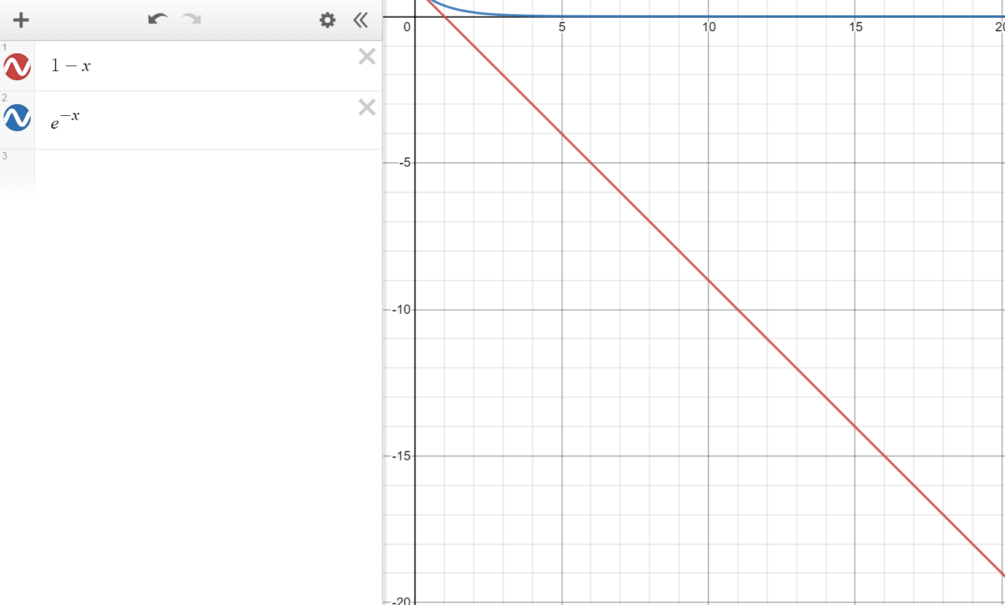
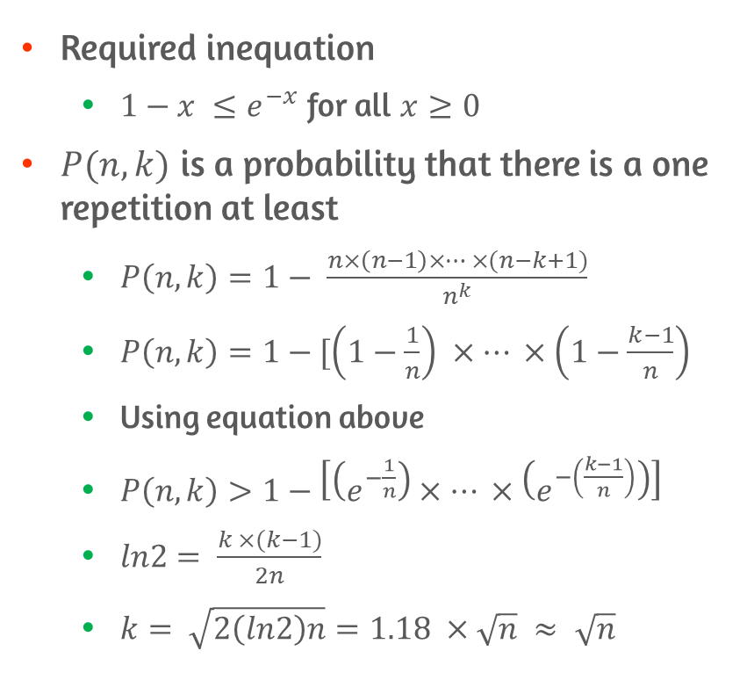
Birthday Paradox Proof
Required inequation
$1−x ≤e^{−x}$ for all $x≥0$
$P(n,k)$ is a probability that there is a one repetition at least
$P\left(n,k\right)=1− \frac{n×\left(n−1\right)×… ×(n−k+1)}{n^{k}}$
$P\left(n,k\right)=1−[\left(1−\frac{1}{n}\right) ×… ×\left(1−\frac{k−1}{n}\right)$
Using equation above
$P\left(n,k\right)>1−\left[\left(e^{−\frac{1}{n}}\right)×… ×\left(e^{−\left(\frac{k−1}{n}\right)}\right)\right]$
$ln2= \frac{k ×(k−1)}{2n}$
$k= \sqrt{2\left(ln2\right)n}=1.18 ×\sqrt{n} ≈ \sqrt{n}$

Slide 22
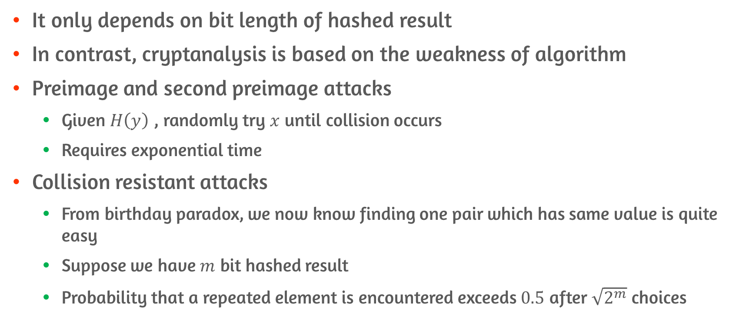
Brute-Force Attacks
It only depends on bit length of hashed result
In contrast, cryptanalysis is based on the weakness of algorithm
Preimage and second preimage attacks
Given $H\left(y\right)$ , randomly try $x$ until collision occurs
Requires exponential time
Collision resistant attacks
From birthday paradox, we now know finding one pair which has same value is quite easy
Suppose we have $m$ bit hashed result
Probability that a repeated element is encountered exceeds $0.5$ after $\sqrt{2^{m}}$ choices

Slide 23
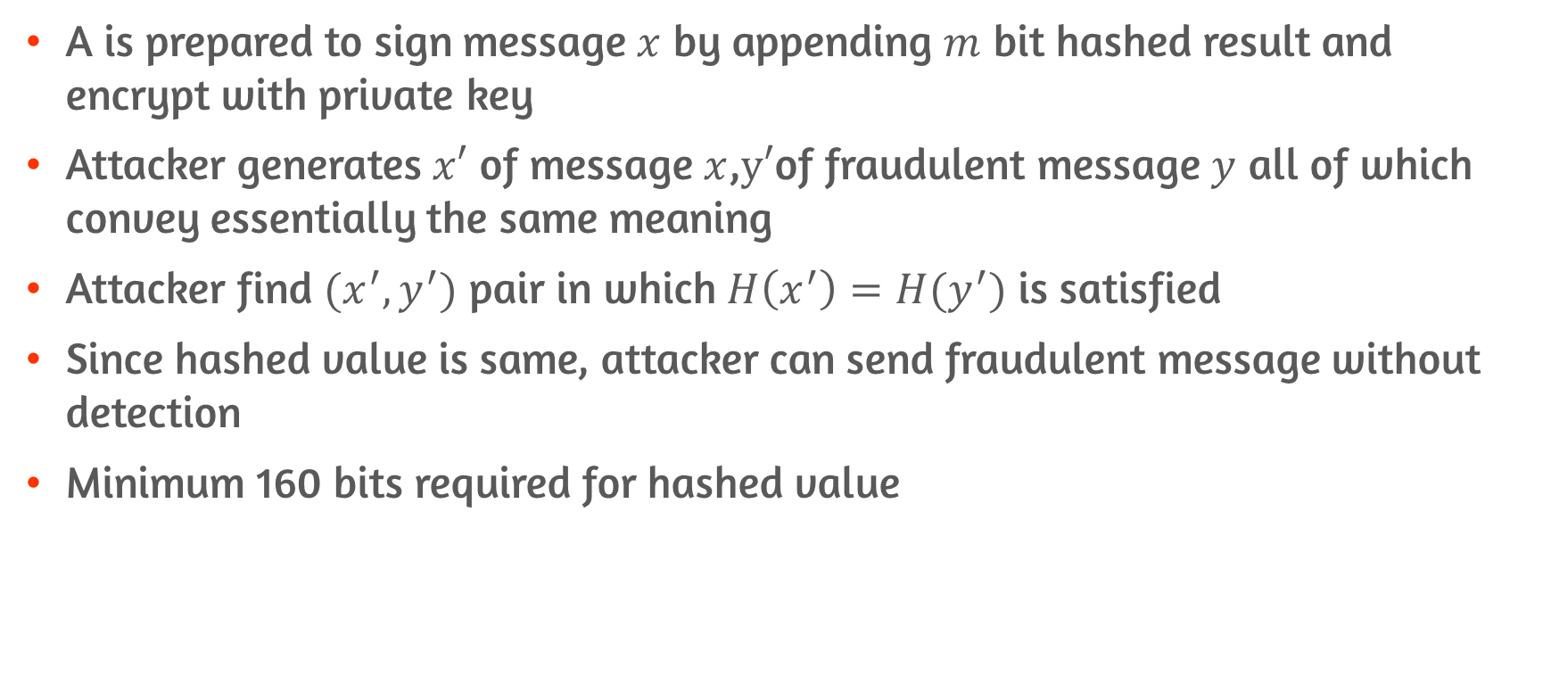
Collision Resistant Attacks
A is prepared to sign message $x$ by appending $m$ bit hashed result and encrypt with private key
Attacker generates $x′$ of message $x$,$y′$of fraudulent message $y$ all of which convey essentially the same meaning
Attacker find $(x^{′},y^{′})$ pair in which $H\left(x^{′}\right)=H(y^{′})$ is satisfied
Since hashed value is same, attacker can send fraudulent message without detection
Minimum 160 bits required for hashed value

Slide 24
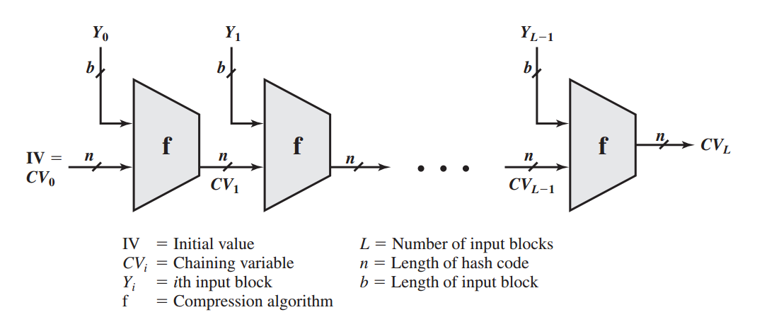
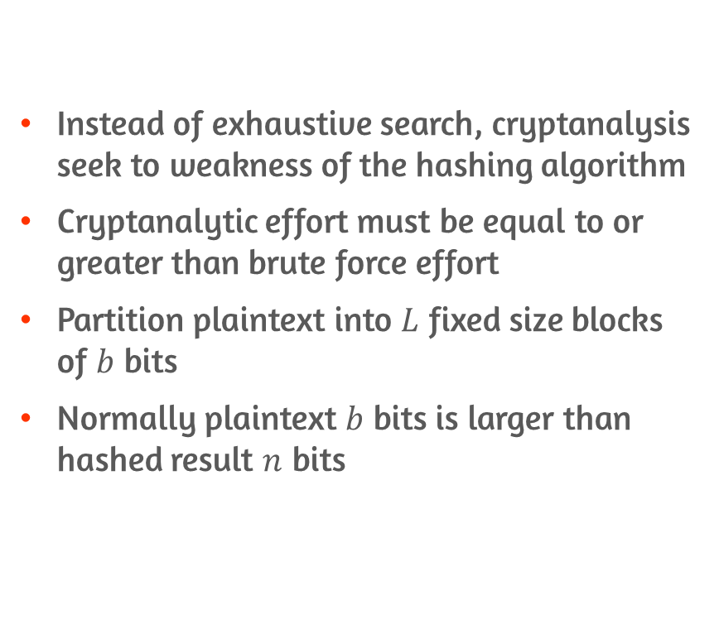
Cryptanalysis and Compression Function
Instead of exhaustive search, cryptanalysis seek to weakness of the hashing algorithm
Cryptanalytic effort must be equal to or greater than brute force effort
Partition plaintext into $L$ fixed size blocks of $b$ bits
Normally plaintext $b$ bits is larger than hashed result $n$ bits

Slide 25
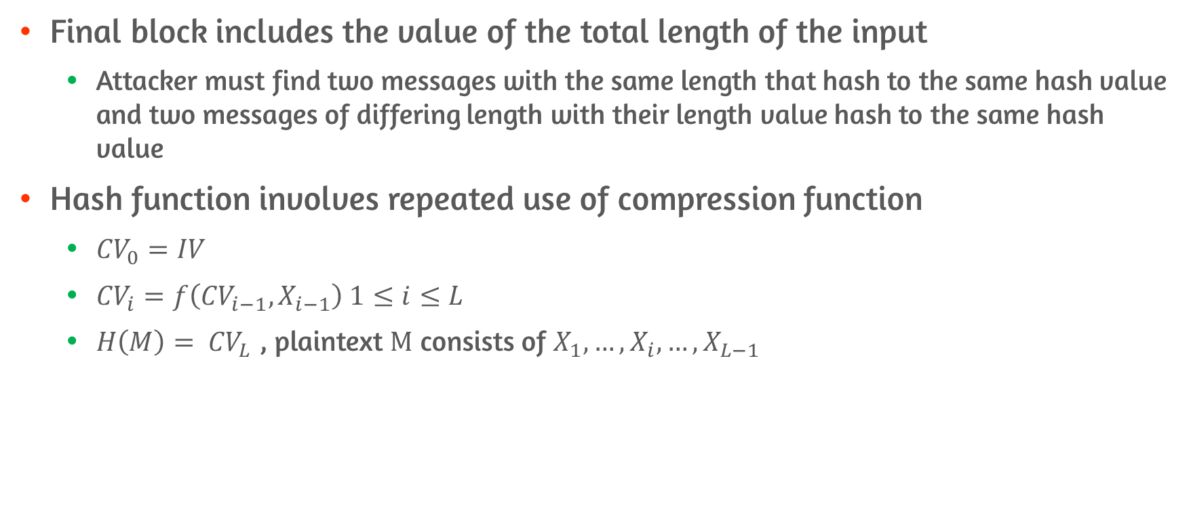
Compression Function
Final block includes the value of the total length of the input
Attacker must find two messages with the same length that hash to the same hash value and two messages of differing length with their length value hash to the same hash value
Hash function involves repeated use of compression function
${CV}_{0}=IV$
${CV}_{i}=f\left({CV}_{i−1},X_{i−1}\right) 1≤i≤L$
$H\left(M\right)= {CV}_{L}$ , plaintext $M$ consists of $X_{1},…,X_{i},…,X_{L−1}$

Slide 26
11.4 Hash Functions Based on CBC

Slide 27
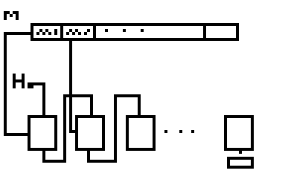
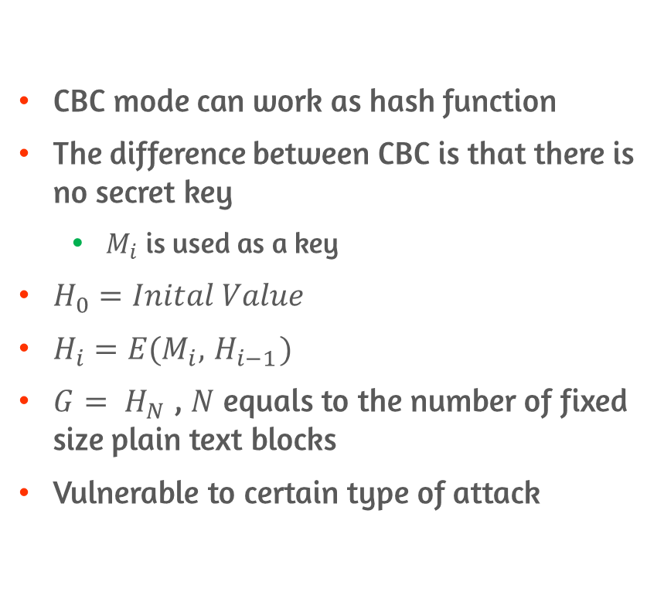
CBC
CBC mode can work as hash function
The difference between CBC is that there is no secret key
$M_{i}$ is used as a key
$H_{0}=Inital Value$
$H_{i}=E(M_{i},{ H}_{i−1})$
$G= H_{N}$ , $N$ equals to the number of fixed size plain text blocks
Vulnerable to certain type of attack

Slide 28
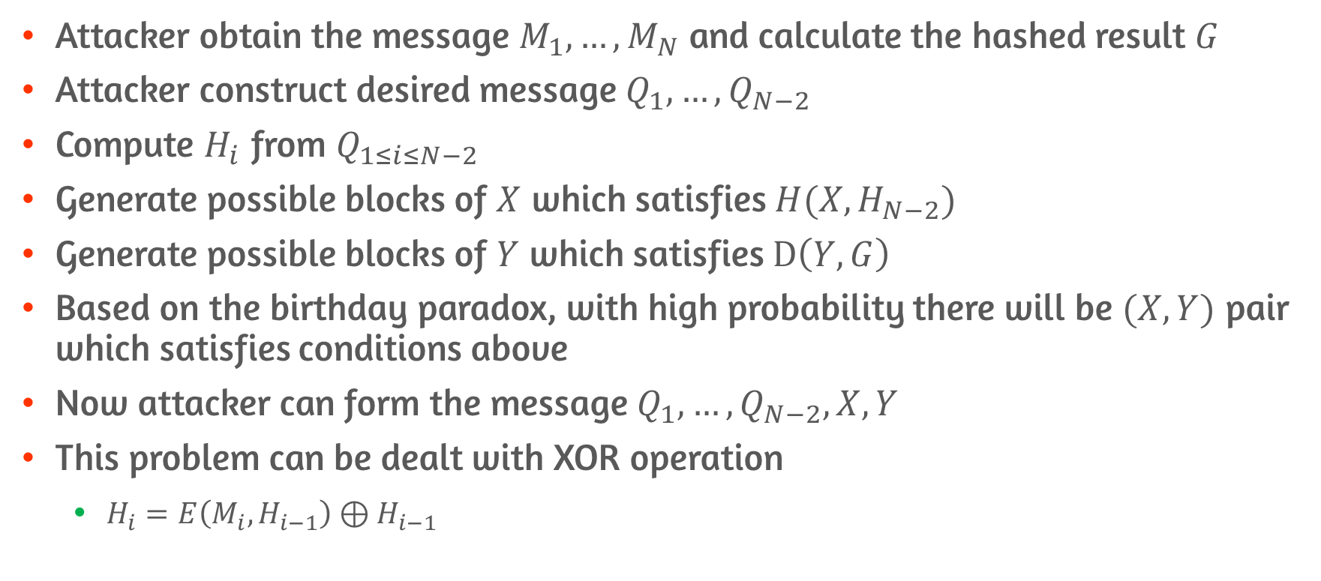
Meet-in-the-middle-attack
Attacker obtain the message $M_{1},…,M_{N}$ and calculate the hashed result $G$
Attacker construct desired message $Q_{1},…,Q_{N−2}$
Compute $H_{i}$ from $Q_{1≤i≤N−2}$
Generate possible blocks of $X$ which satisfies $H(X,H_{N−2})$
Generate possible blocks of $Y$ which satisfies $D\left(Y,G\right)$
Based on the birthday paradox, with high probability there will be $(X,Y)$ pair which satisfies conditions above
Now attacker can form the message $Q_{1},…,Q_{N−2},X,Y$
This problem can be dealt with XOR operation
$H_{i}=E\left(M_{i}, H_{i−1}\right)⊕H_{i−1}$

Slide 29
11.5 SHA

Slide 30
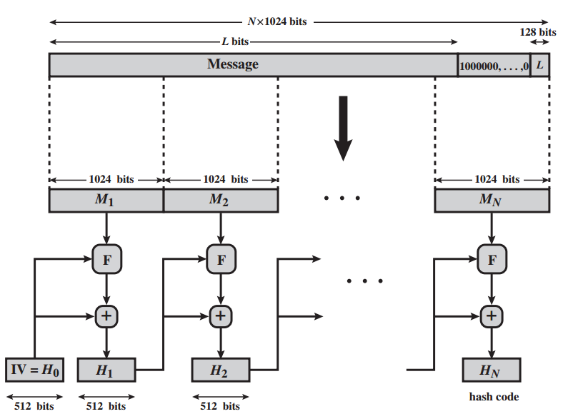
SHA-512 Overview

Slide 31
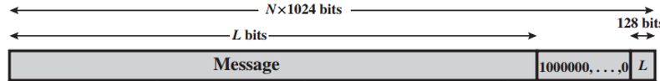
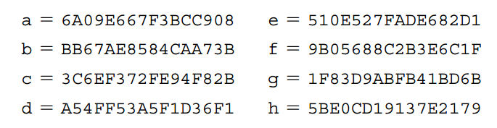
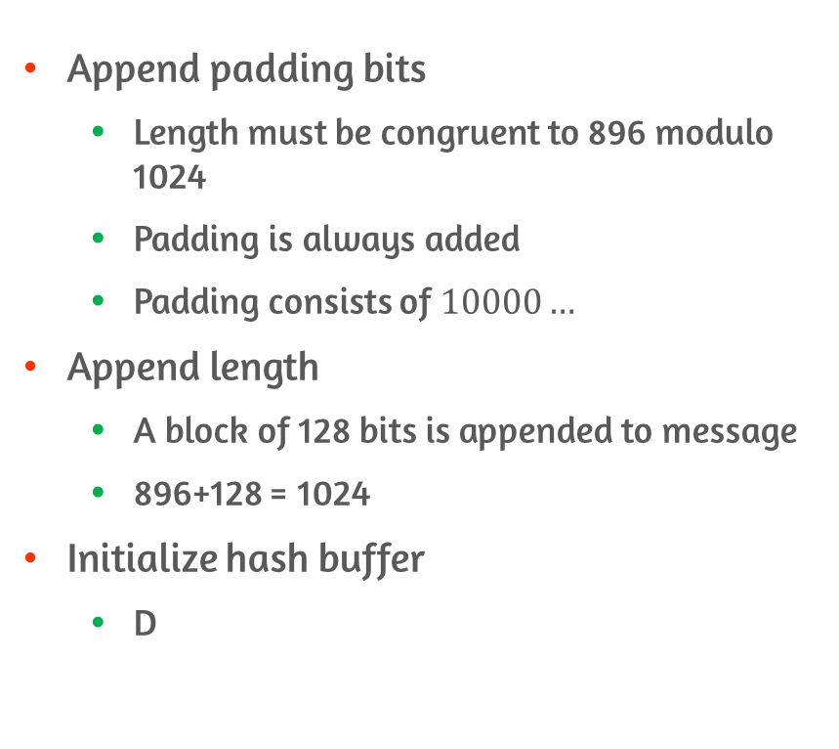
SHA-512 Logic #1
Append padding bits
Length must be congruent to 896 modulo 1024
Padding is always added
Padding consists of $10000…$
Append length
A block of 128 bits is appended to message
896+128 = 1024
Initialize hash buffer
D

Slide 32
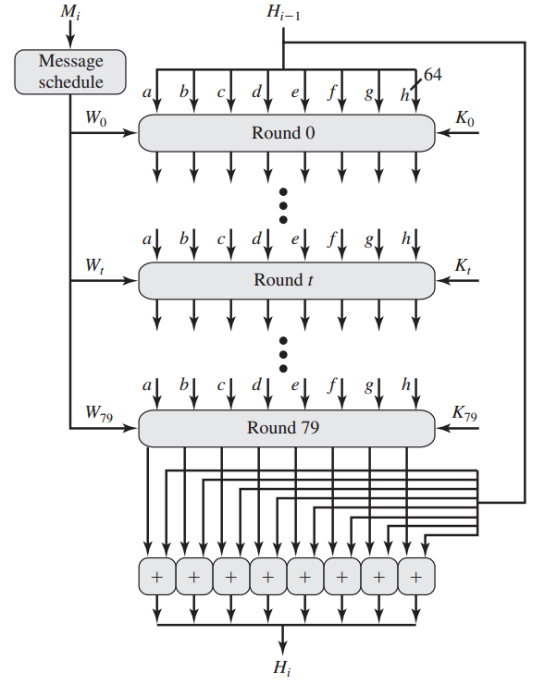
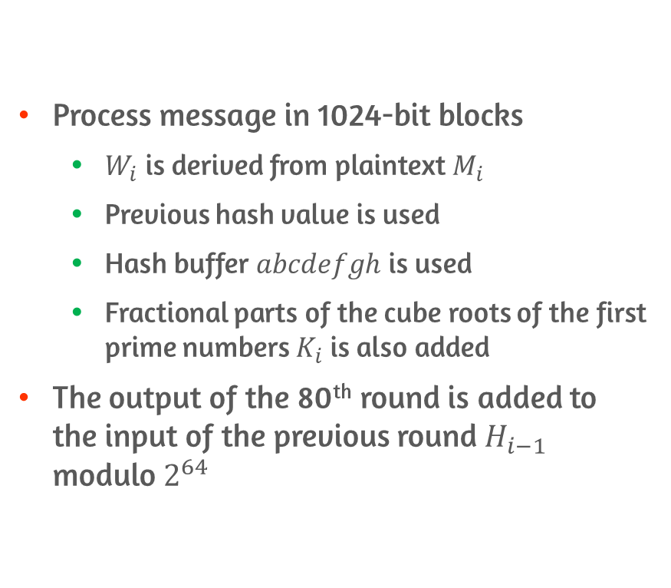
SHA-512 Logic #2
Process message in 1024-bit blocks
$W_{i}$ is derived from plaintext $M_{i}$
Previous hash value is used
Hash buffer $abcdefgh$ is used
Fractional parts of the cube roots of the first prime numbers $K_{i}$ is also added
The output of the 80th round is added to the input of the previous round $H_{i−1}$ modulo $2^{64}$

Slide 33
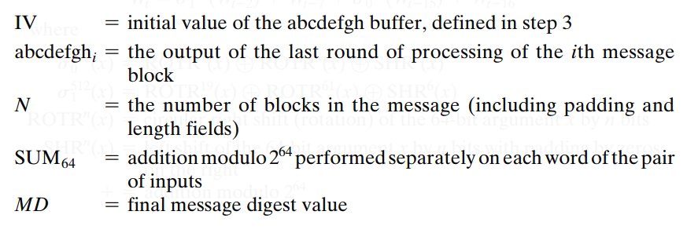
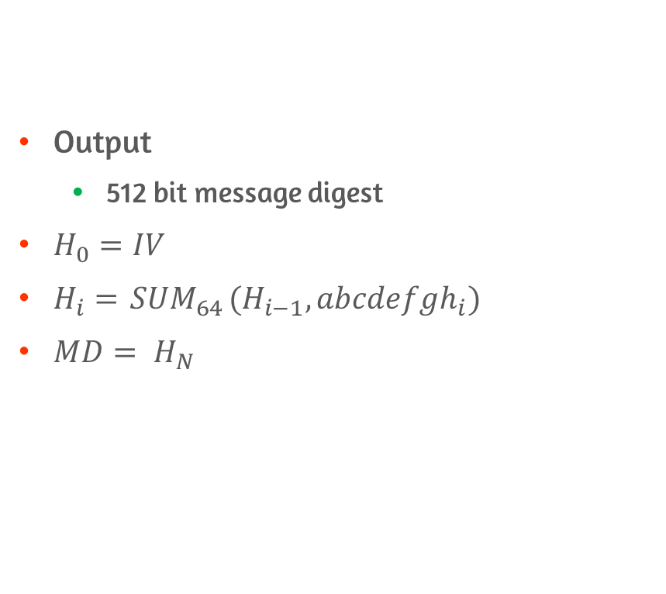
SHA-512 Logic #3
Output
512 bit message digest
$H_{0}=IV$
$H_{i}={ SUM}_{64}(H_{i−1},{abcdefgh}_{i})$
$MD= H_{N}$

Slide 34
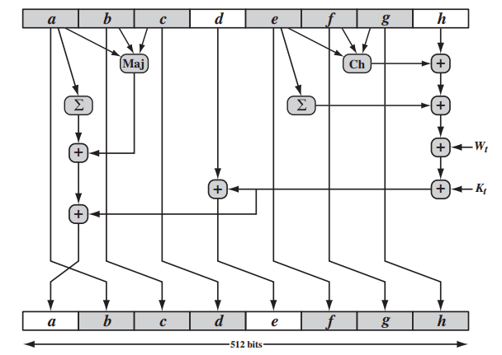
SHA-512 Round Function
SHA-512 round function has the property that every bit of the hash code is a function of every input
This complex mechanism produces results that are well mixed

Slide 35
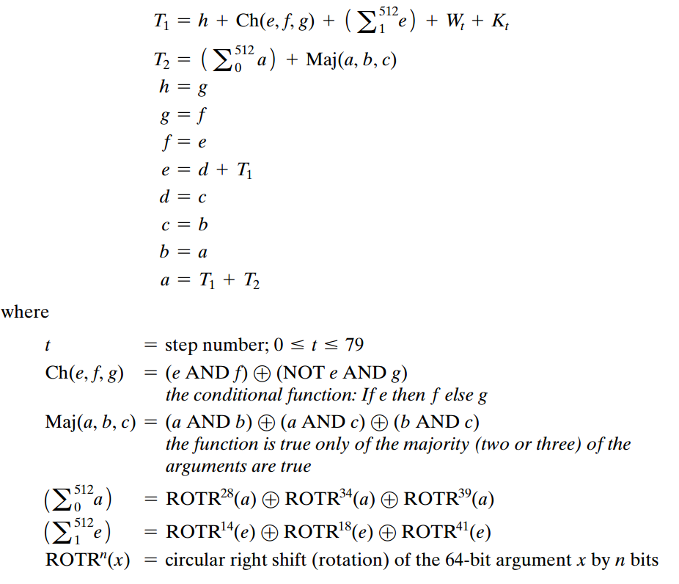
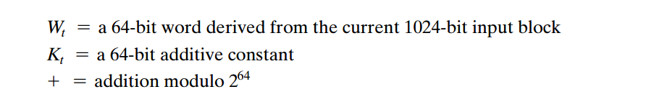
Appendix A, SHA-512 Round Function

Slide 36
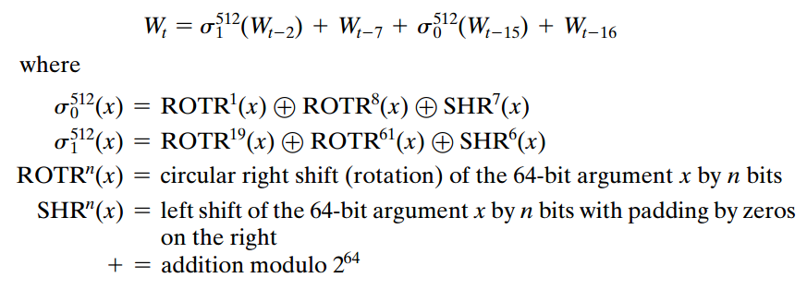
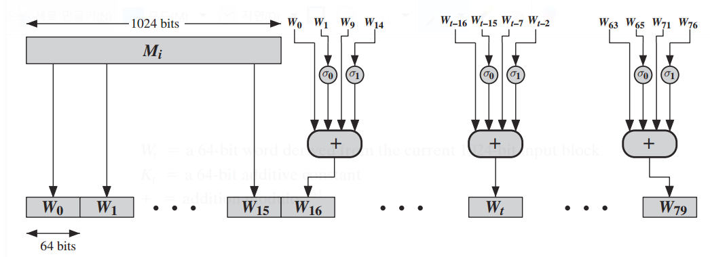

Appendix B, SHA-512 $W$ derivation

Slide 37
Conclusion
Summarize the applications of cryptographic hash functions
Preimage resistant, second preimage resistant, collision resistant
Birthday paradox
Basic Structure of cryptographic hash functions
CBC hash functions
SHA-512

